Slide 1
Deploy React App on AWS S3 using CI/CD
By Mahendra Choudhary

Slide 2
Objectives
Simplify the deployment process for React.js applications.
Automate deployment pipeline using GitHub Actions.
Enable scalable hosting of React.js apps on AWS S3.
Deliver exceptional user experiences through reliable deployments.
Empower developers with knowledge and tools for efficient deployment and hosting.

Slide 3
Prerequisites
Basic understanding of React.js.
GitHub account for repository hosting and GitHub Actions.
AWS S3 account for hosting the React.js application.
Access and permissions for GitHub and AWS S3.
Familiarity with YAML configuration.
Command-line interface (CLI) proficiency.

Slide 4
Creating Repository
Go to account
Create new repository with name(Ex. React App)
Make sure you select it as Public
Uncheck Readme.md
Now you will have to setup React App in local machine
After this set origin of this repo to local React-App (Refer next slide …)

Slide 5
Basic React JS project on local machine
Prerequisite:
Nodejs V18, NPM, Git, VScode should be installed on your machine
Local machine should have internet connection.
Run command: npx create-react-app react-app
CD react-app
Now set up the origin of github repo to this project:
Example:
git remote add origin https://github.com/whoismayank/react-app.git
git branch -M main
git push -u origin main
Now you are done setting up your project to create CI/CD pipeline

Slide 6
Create IAM user on AWS
Go to AWS Console
Search IAM
Click on users
Click on Create user button
Give user name
Click next and select tab “Attach policies directly”
Search for “AmazonS3FullAccess”
Create an IAM user and attach the AmazonS3FullAccess policy.
Download the .csv file of the secret access key.

Slide 7
Create an S3 bucket
Go to AWS console
Search S3
Click on “Create Bucket” button
Give bucket name
Select “Object Ownership” as “ACLs enabled”
Scroll down and uncheck “Block all public access” (Check acknowledge)
Click on “Create bucket” button
Your s3 bucket successfully created….

Slide 8
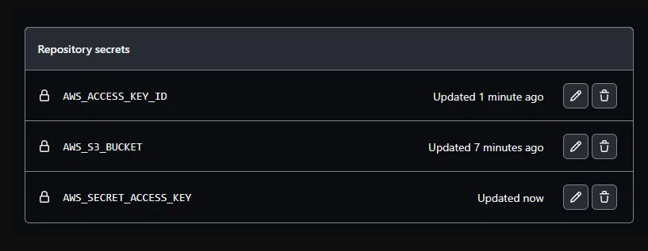
Configure IAM Secrets to github Repo
Go github repo on github.com
Go to settings tab
Scroll down and click on “Secrets and variables” tab in sidebar
Click on “Secrets and variables” -> “Actions”
Add secrets from a csv file that you have downloaded earlier
AWS_S3_BUCKET
AWS_ACCESS_KEY_ID
AWS_ACCESS_KEY_ID
Your secrets should look like this:

Slide 9
Setup CI/CD workflow manifest
In your local repo folder
Create folder: .github\workflows
Create manifest file main.yml
Paste below content
name: React Website
on:
push:
branches: [ "main" ]
pull_request:
branches: [ "main" ]
jobs:
build:
runs-on: ubuntu-latest
steps:
- name: Checkout code
uses: actions/checkout@v2
- name: Set up Node.js
uses: actions/setup-node@v2
with:
node-version: '14'
- name: Install dependencies
run: npm install
- name: Build app
run: npm run build
- name: Upload to S3
uses: jakejarvis/s3-sync-action@master
with:
args: --acl public-read
env:
SOURCE_DIR: build/
AWS_S3_BUCKET: ${{ secrets.AWS_S3_BUCKET }}
AWS_ACCESS_KEY_ID: ${{ secrets.AWS_ACCESS_KEY_ID }}
AWS_SECRET_ACCESS_KEY: ${{ secrets.AWS_SECRET_ACCESS_KEY }}

Slide 10
Push changes and configure S3 for web hosting
Once you created workflow file push to changes to main branch
You can see your CI/CD pipeline running in Github -> your repo -> Actions
Once it completed go to your s3 bucket. You can see all the uploaded files here
Now go to the Properties section and scroll down to the end
You can see the Static website hosting option. Click on edit and enable it and write index.html in the index document section.
Then save changes.
Now you can see a link in the static website hosting section. Open it in a new tab
Hooray!! You can see that your React application is live now. Whenever you change your code and push it to GitHub, you will see new changes here within a few seconds.

Slide 11
Thank you
If you have any questions, feel free to reach out later.
Mahendra Choudhary
Notes:
https://www.youtube.com/watch?v=X3F3El_yvFg&ab_channel=TraversyMedia

